Slide 1
Modeling the Synapse

Slide 2
Neurotransmission
Action
Potential
Synapse
PSP
Post-synaptic
Terminal
Pre-synaptic
Terminal

Slide 3
What happens at the synapse?
The presynaptic terminal releases a substance called neurotransmitter (NTS)
NTS binds with a Receptor on the post-synaptic side
The receptor opens/closes an ion channel

Slide 4
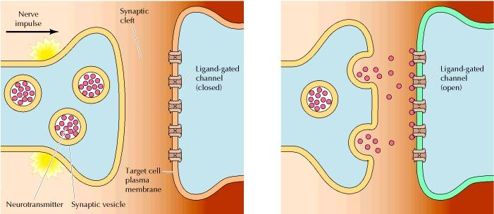

Slide 5
Excitatory synapses
EPSP
If the NTS-Receptor binding event opens a Na+ channel, post-synaptic potential increases ➔ EPSP

Slide 6
Inhibitory synapses
IPSP
If the NTS-Receptor binding event opens K+ channels, (or Cl- channels), post-synaptic potential decreases ➔ IPSP

Slide 7
Synaptic Strength
Action
Potential
Synapse
PSP
Post-synaptic
Terminal
Pre-synaptic
Terminal
Synaptic strength:
= average PSP produced in response to
an AP on the presynaptic side.

Slide 8
Neurotransmitter | Type | Receptor(s) | Ion Channel
Glutamate | Excit | AMPA NMDA Kainate | Na+
GABA (Gamma-amino Butyric acid) | Inhib | GABA_A, GABA_B | Cl-

Slide 9
Synapse
AP → NTs → PSP.
Modeling the transient increase and return to zero of synaptic conductance g_{syn}(t)
when g_{syn}(t) > 0
Post Synaptic Potential variation:

Slide 10
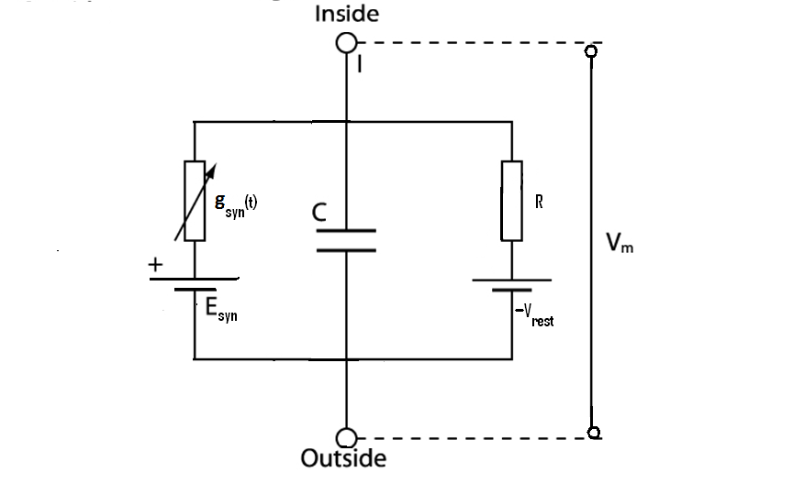
PSP circuit model
g_{syn}(t) – is the time-varying synaptic conductance (of the ion channel involved in synaptic transmission)
E_{syn} – is the Nernst potential corresponding to the ion channel (involved in synaptic transmission) and the ionic species to which it is permeable
C – membrane capacitance
Vrest – resting membrane potential of the postsynaptic membrane
R – membrane resistance

Slide 11
PSP
Is deviation from the resting potential of the Post Synaptic Membrane
(PSP), v = V_{m} – V_{rest}
-- (*)

Slide 13
3 cases
The direction of change in v can be expressed in 3 cases:
Case 1) Esyn > Vrest
Case 2) Esyn < Vrest
Case 3)

Slide 14
Case 1) Esyn > Vrest
v transiently increases. → EPSP.
Ex: fast, excitatory synapses with AMPA receptors (or non-NMDA type) and glutamate as neurotransmitter.

Slide 15
Case 2) Esyn < Vrest
Current injected is negative, → negative deviation in v, → IPSP
Ex: Some potassium channels with GABA as the neurotransmitter and GABA_B as the receptor.

Slide 16
Case 3)
No current in the synaptic conductance
No apparent effect on the PSP.
Ex: Some Cl channels having GABA synapse with GABA_A receptor.
Although these synapses do not seem to have any effect in isolation, when used in conjunction with excitatory synapses they show an interesting effect.

Slide 17
Case 3 with Excitatory synapses
Here EPSP produced is smaller than what it would be when the excitatory synapse alone is present.
In that sense, the synapse corresponding to
is inhibiting the excitatory synapse.
Therefore it is known as a silent or a shunting inhibition.

Slide 18
This additional term reduces the amplitude of ν(t)

